Slide 1
ETHICAL CONCERNS IN MACHINE LEARNING
SOC 2101 – Society, Environment and Engineering Ethics
Course teacher: Saifur Rahman

Slide 2
IMAGINE …
You are a Laravel* developer. Whenever you face any problem during your development, you Google your problem, and try to get the best solution. You usually get the best helps from the forum named Laracast, although there is another wonderful forum named StackOverflow.
If you search your Laravel problem on some random day, which website is the most likely to pop up as the first result?

Slide 3
GOOGLE IS LEARNING FROM OUR SEARCH HISTORY!!!

Slide 4
MACHINE LEARNING
Teaching computers how to learn from data to make decisions or predictions
The computer must be able to learn to identify patterns without being explicitly programmed to
Part of the study of Artificial Intelligence
Machine Learning (ML) is a branch of artificial intelligence (AI) that allows computers to learn from data and make decisions or predictions without being explicitly programmed for every task.

Slide 5
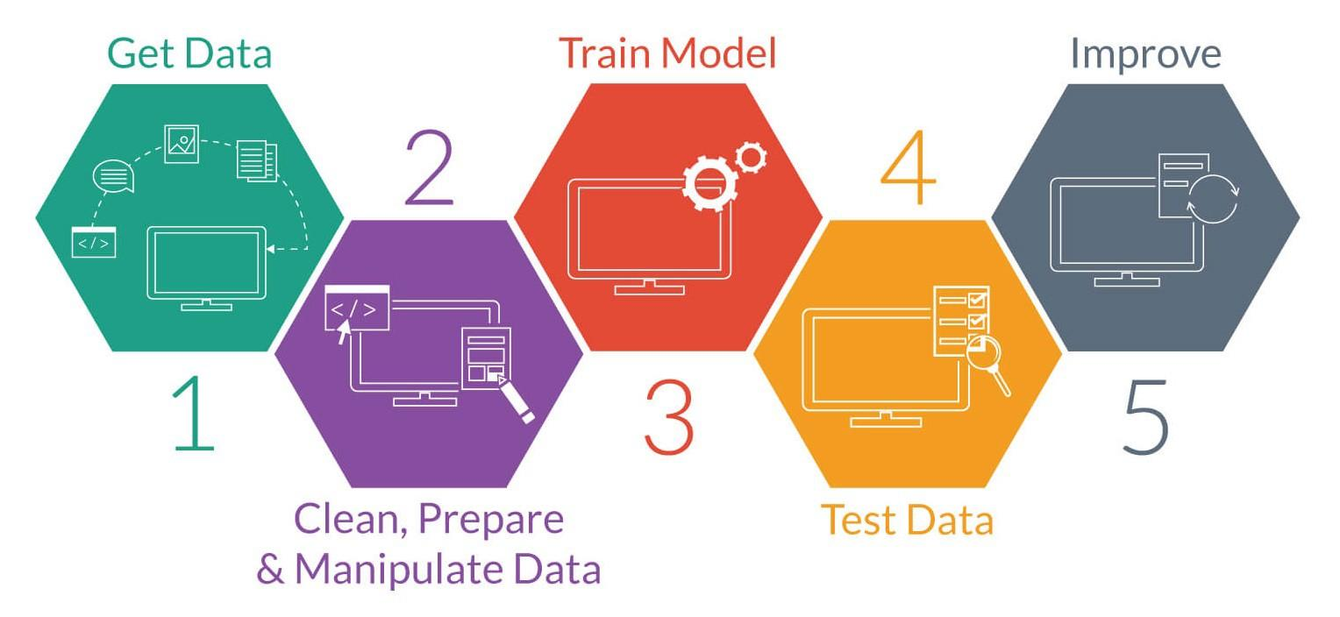
MACHINE LEARNING WORKFLOW

Slide 6
WHAT DOES FACEBOOK SHOW YOU IN YOUR HOMEPAGE?
To be more specific, stories of which friends do you see?

Slide 7
FACEBOOK’S MACHINE LEARNING
Facebook’s policy is to show you contents of those friends who you interact with the most
Reactions
Comments
Chats
Post/comment/photo tags
If you reduce communicating with your (once) best friends, Facebook will probably make you forget them
If you are fond of memes, Facebook will show you more memes
If you are fond of propaganda news, Facebook will show you the same

Slide 8
FACEBOOK IS LEARNING FROM OUR INTERACTION WITH EVERY CONTENT!!!

Slide 9
ETHICAL CONCERNS IN MACHINE LEARNING
Is the target system ethical?
Is the process ethical?
Is the data source ethical?
Is the data ethical?
Is the impact ethical?

Slide 10
PRIVACY AND SURVEILLANCE
Access to private data and personally identifiable data
Aspects of privacy –
The right to be left alone
Information privacy
Control over information about oneself
The right to secrecy

Slide 11
PRIVACY AND SURVEILLANCE
Our modern digital lifestyle leads to digital collection of our data
Possibilities of intelligent data collection, and data analysis
“In this vast ocean of data, there is a frighteningly complete picture of us”

Slide 12
PRIVACY-PRESERVING TECHNIQUES
Anonymization
Access control
Encryption

Slide 13
MANIPULATION OF BEHAVIOR
Information collected may be used to manipulate behavior, online and offline
User’s intense interaction with data systems make him/her vulnerable to “nudges” especially designed for him/her
Make one unintentionally purchase something/subscribe to some service
Manipulate one’s thought process

Slide 14
THE CAMBRIDGE ANALYTICA SCANDAL
The power of data-driven behavior manipulation

Slide 15

CAMBRIDGE ANALYTICA
A British political consulting firm which collected huge number of data from Facebook
used them for building psychographic profiles of the users
Cambridge Analytica was a consultant of Donald Trump’s 2016 US Election campaign, and Leave.EU’s Brexit campaign!!
The campaign team used micro-targeting technique
Trump supporters were shown triumphant visuals of him
Swing voters were informed of Trump’s notable supporters, and negative ideas of his opponent Hillary Clinton
Was Cambridge Analytica’s works ethical?
Let’s discuss

Slide 16
BIAS IN DECISION SYSTEMS
Bias due to discriminatory preconception about members of a group
Cognitive biases
Statistical biases
Historical biases

Slide 17
AMAZON’S BIASED RECRUITING TOOL
Notes:
https://research.aimultiple.com/ai-bias/

Slide 18
AMAZON’S AUTOMATING RECRUITING PROCESS
AI reviewed job applicants’ resumes and rated applicants so that recruiters don’t spend much time on resume screening.
Amazon has used the last 10 years’ historical data to train its AI model. The data was male-dominated, as 60% of Amazon’s employees consisted of men.
What kind of bias is likely to be introduced here?
Notes:
What kind of bias is likely to be introduced here?
AI incorrectly learnt to penalized resumes that included the word “women’s,” as in “women’s chess club captain.”

Slide 19
RACIAL BIAS IN HEALTHCARE RISK ALGORITHM
Notes:
https://research.aimultiple.com/ai-bias/

Slide 20
RACIAL BIAS IN HEALTHCARE RISK ALGORITHM
AI predicts which patient is likely to need extra medical care. More than 200 million U.S. citizens data was used.
What kind of bias is likely to be introduced here?
What was the reason for bias?
Notes:
What kind of bias is likely to be introduced here?
AI incorrectly learnt to favor white patients over black patients.
What was the reason for bias?
Faulty metric. AI designers used previous patients’ healthcare spending as a proxy for medical needs. This was a bad interpretation of historical data because income and race are highly correlated metrics and making assumptions based on only one variable of correlated metrics led the algorithm to provide inaccurate results.

Slide 21
HOW TO FIX BIASES IN ML ALGORITHMS?
Remove data bias
not fully possible
Remove algorithmic bias
Should we remove columns likely to cause bias (such as sex or race) ?
ML interpretability
understand why a model is making a particular decision
Notes:
An AI system can be as good as the quality of its input data. If you can clean your training dataset from conscious and unconscious assumptions on race, gender, or other ideological concepts, you are able to build an AI system that makes unbiased data-driven decisions.
It is not possible to create completely unbiased data due to numerous human biases.
After all, humans are creating the biased data while humans and human-made algorithms are checking the data to identify and remove biases.
https://www.slideshare.net/vladimirkanchev/ethical-issues-in-machine-learning-algorithms-part-2-140369359
Remove algorithmic bias
Should we remove columns likely to cause bias (such as sex or race) ?
May not work
Removing male-female label is not enough to remove data bias
Model accuracy may get worse.

Slide 22
OPACITY OF AI SYSTEMS
AI systems will extract patterns from a given dataset
Many AI systems are black boxes (such as deep neural network, random forest)
Even programmers who designed the system do not know how the system identified a pattern
AI systems are thus opaque to the user and even to the experts usually
What if they learn the wrong thing? Difficult to trust its decision
We need explainable/interpretable ML in high-stakes decision makings (e.g. medical diagnostic software)
to make the system fair and transparent, and thus trustworthy
to protect consumers

Slide 23
REFERENCES
Bias in AI: What it is, Types & Examples of Bias & Tools to fix it: https://research.aimultiple.com/ai-bias/

